Slide 1
Group 4 - Spellemental
Ben Carter, Bethany Cowle, Caleb Guppy, Victor Sicoe

Slide 2
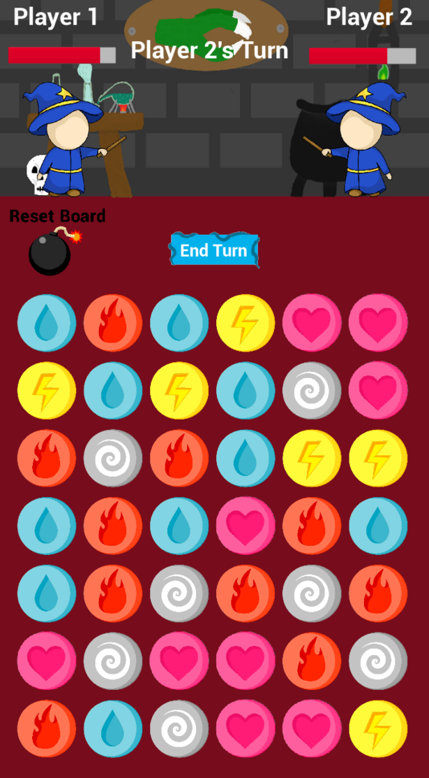
Game Basics
Turn based
Competitive
Puzzle game
Magic theme

Slide 3
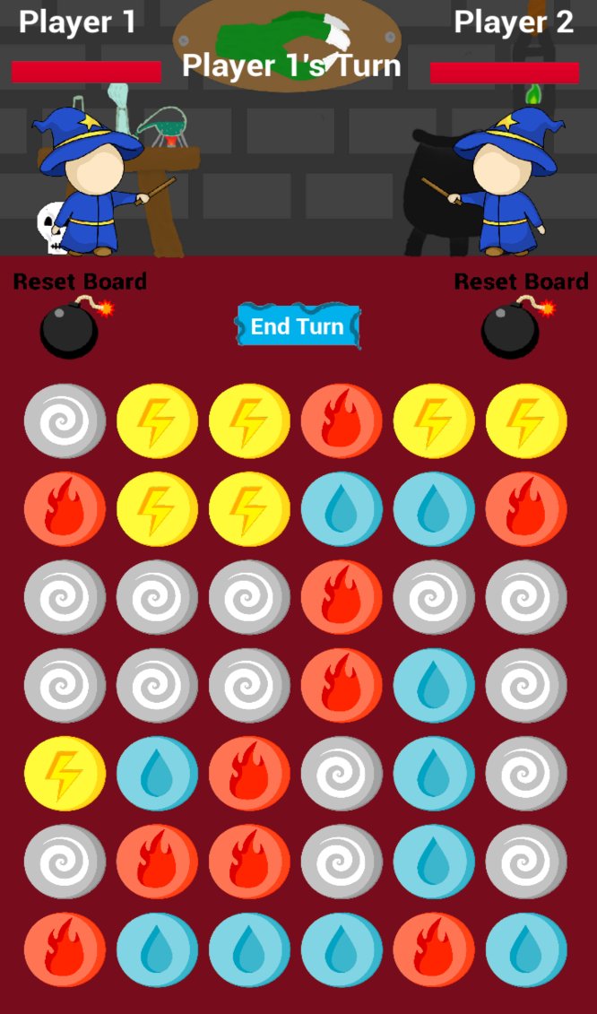
Game Loop
Weakness selection
Player One selects combo.
Player Two takes damage.
Player Two selects combo.
Player One takes damage.
Repeat.
The player with 0 HP loses.

Slide 4
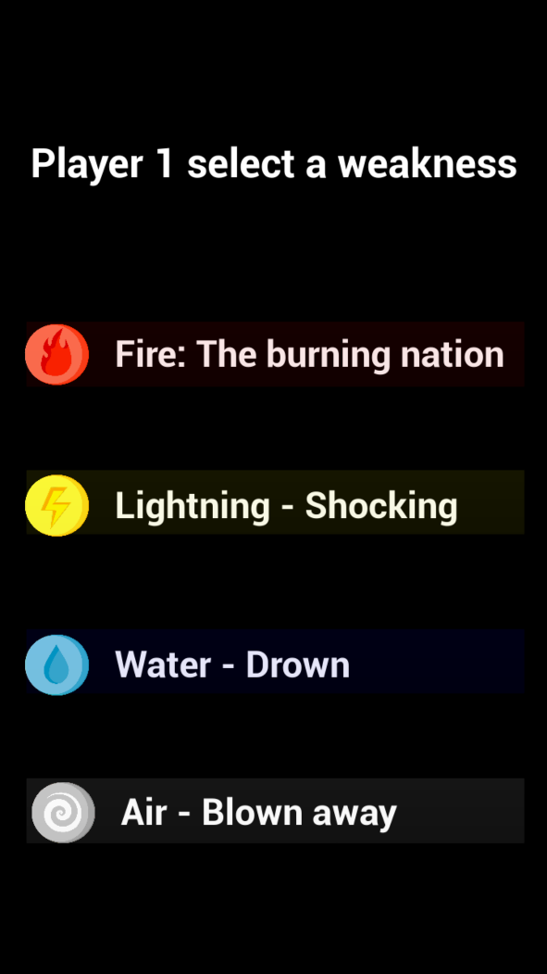


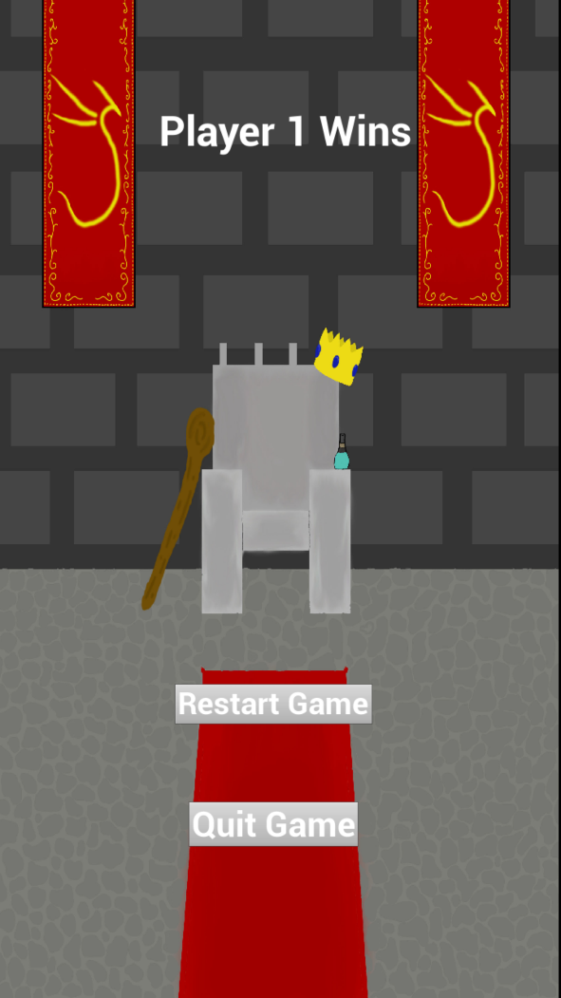
How To Play – Base Game

Slide 5

How To Play – Power-Up’s
Reset Board Power-Up
Tiles are reset.
Limited use.
HP Tile
Tiles heal player.
Uses a turn.

Slide 6
Gameplay Video
Insert video

Slide 7
Target Demographic
Casual gamers
Art style – cute, simple, magic theme
Affordances
Easy to learn and play

Slide 8
Gameplay
People fun
Mix of chance and skill
Competitive

Slide 9

Iterations based on Playtesting & Feedback
Tile selection
Healing tiles
Animations
Sounds

Slide 10
Moving Forward
Art assets for buttons, health bars
Animations
Polishing

